Slide 1
African Migration Governance in Action
Policy frameworks and legislative instruments of Regional Economic Communities

Slide 2
Objectives
Identify the main migration and forced displacement legislation and policy initiatives of the African Union and its Regional Economic Communities (RECs)
Appreciate the institutional characteristics, priorities and position of African regional organizations in the governance of migration;
Appreciate a case study of the IGAD Regional Migration Policy Framework and its institutional coordinating mechanisms in the Governance of Migration and Forced Displacement.

Slide 3
General Scope
Binding
Main categories include:
Labour Migration
Trafficking & Smuggling
Free Movement
Internal Migration
Main categories include:
Refugees
IDPs
Returnees
Migration
Forced Displacement
Non-Binding

Slide 4
Overview AU’s Migration and Displacement Policies
POLICY | YEAR | TOPIC | BINDING
OAU Convention Governing the Specific Aspects of Refugee Problems in Africa | 1969 | Refugees | Yes
The Migration Policy Framework for Africa | 2006 | Migration general | No
African Common Position on Migration and Development | 2006 | Migration general | No
Declaration on the African Union Border Programme | 2007 | Borders | No
Convention for the Protection and Assistance of Internally Displaced Persons in Africa - "Kampala Convention" | 2009 | IDPs | Yes
Minimum Integration Programme | 2009 | Labour migration | No
Khartoum Declaration on AU-Horn of Africa Initiative on Trafficking and Smuggling of Migrants | 2014 | Trafficking | No
Joint Labour Migration Governance for Development and Integration in Africa Programme | 2015 | Labour migration | No
Declaration on Migration | 2015 | Migration general | No
African Continental Free Trade Area (AfCFTA) | 2018 | Trade and Services | Yes
Africa Continental Free Movement of Persons Protocol | 2018 | Free Movement | Yes

Slide 5
Key Frameworks on Forced Displacement
OAU Refugee Convention
Adopted in 1969 and entered into force in 1974.
46 out of the 55 AU member states have ratified the convention
Hailed for its broader definition of the term 'refugee'
1
Kampala Convention
Adopted in 2009 and entered into force in 2012. Ratified by 31 of the 55 MS
It’s the first legally binding regulatory framework to protect IDPs.
Priorities include prevention and prohibition of displacement, the protection of the human rights of IDPS and their assistance, and the introduction of an early warning system.
Primary responsibility lies with the state.
2
Ranking and
shortlist of locations
African Charter on Human and Peoples' Rights (ACHPR)
Adopted in 1981 and came into force 1986
The Charter has been ratified by 54 out of 55
The charter primarily outlines the right of an individual to seek asylum, seek protection of from mass expulsion, or freedom of movement and residence within the borders of the State s/he abides by the law, and the persons’ right to leave and return to his/her State.
3
Selection of
suitable
location
African Charter on the Rights and Welfare of the Child (ACRWC)
Adopted in 1990 and signed by all the AU members, only 7 States are yet to ratify the convention
the ACRWC provides specific protection to asylum seeker or refugee children and to internally displaced children following internal armed conflict, natural disaster or any other cause for displacement.
4

Slide 6
Key Frameworks on Migration
Migration Policy Framework for Africa
Adopted in 2006 and revised in 2018.
It provides Member States and RECs with comprehensive policy guidelines and principles to assist in the formulation and implementation of their own national and regional migration policies in accordance with their priorities and resources.
The revised MPFA identifies 8 priority areas/pillars.
1
The African Common Position on Migration & Development
Presents the agreed position of the AU member states on 11 priority policies related to migration and recommendations for actions on different levels, such as the national, continental and international level.
Prioritizes national and regional specificities, capacity building, regional cooperation and expanded pathways for labour migration
2
Ranking and
shortlist of locations
AU Initiative against Trafficking Campaign)
Launched in 2011 and Commonly referred to as the AU.COMMIT
Aimed at renewing activities of the AU, as well as initiatives on the global, regional and national level, in order to have better coordinated and synergized actions to combatting trafficking
3
Selection of
suitable
location
Joint Labour Migration Programme (JLMP)
Established in 2015 and implemented by AUC, ILO, IOM and UNECA.
Aimed to promote ‘effective implementation of human mobility rules as key to development and integration’ across all RECs
4
Notes:
8 Priority Pillars of the Revised RMPFA:
Migration Governance;
Labour Migration and Education;
Diaspora Engagement;
Border Governance;
Irregular Migration;
Forced Displacement;
Internal Migration;
Migration and Trade
11 Priority policies of the African Common Position on Migration and Development:
Migration and Development: Migration can be an effective tool for development.
Human resource and the brain drain: brain drain is a handicap for sustainable development.
Labour migration: Regular, transparent and comprehensive labour migration policies can result in benefits for states of origin and destination.
Remittances: Remittances play a significant financial role in developing states, but there are difficulties relating to the high cost of effecting remittances.
African Diaspora: Enhancing the involvement of the African Diaspora is a key aspect in fostering the migration-development nexus.
Migration and Peace, Security and Stability: Large spontaneous and unregulated migrant flows can have a significant impact on stability, security, and conflict prevention, as well as on good governance.
Migration and Human Rights: Safeguarding the human rights of migrants is a fundamental component of a balanced migration management and implies the effective application of norms enshrined in human rights instruments as well as in instruments related to the treatment of migrants.
Migration and Gender: Given the increasing number of migrant women, their rights and risks of exploitation should be given particular attention.
Children and Youth: The special needs of children should be adhered to, and child trafficking challenges addressed.
Elderly: The needs of elderly migrants need to be understood and catered to.
Regional initiatives: There is a need to develop common regional policies within the RECs, and for more bilateral and multilateral efforts in labour migration cooperation (AU 2006, art.3).

Slide 7
Key Frameworks on Migration
Declaration on Migration
Adopted in 2015.
It reaffirmed previous commitments on accelerating mobility and integration
Agreed priorities included the speeding up of the implementation of a continent-wide visa, the establishment of a harmonization mechanism to ensure higher education transferability, and the strengthening of efforts to combat human trafficking.
5
Common African position on the Global Compact for Migration
Drafted in 2017 to inform the negotiations of the Global Compact on Migration
Structured around 6 thematic areas; Addressing the drivers of migration, Addressing Human Rights of all Migrants, Smuggling of Migrants, Trafficking in persons and contemporary forms of Slavery, International Cooperation and Governance in Migration, Irregular Migration and Regular Pathways, and Contributions of Migrants and Diasporas
6
Ranking and
shortlist of locations
Continental Protocol on Free Movement of Persons
Adopted in 2018. Ratifications are low
Calls for a phased approach in the progressive realization of free movement of persons across the continent.
Identifies 3 phases: 1) Right of entry and abolition of visa requirements; 2) Right of residence; 3) Right of establishment
7
African Continental Free Trade Zone (AfCFTA)
8
Adopted in 2018,
Came into force in record time. As at May 2022, 43 of the 54 signatories (80%) had deposited their instruments of AfCFTA ratification.
No trade has as yet taken place under the AfCFTA regime

Slide 8
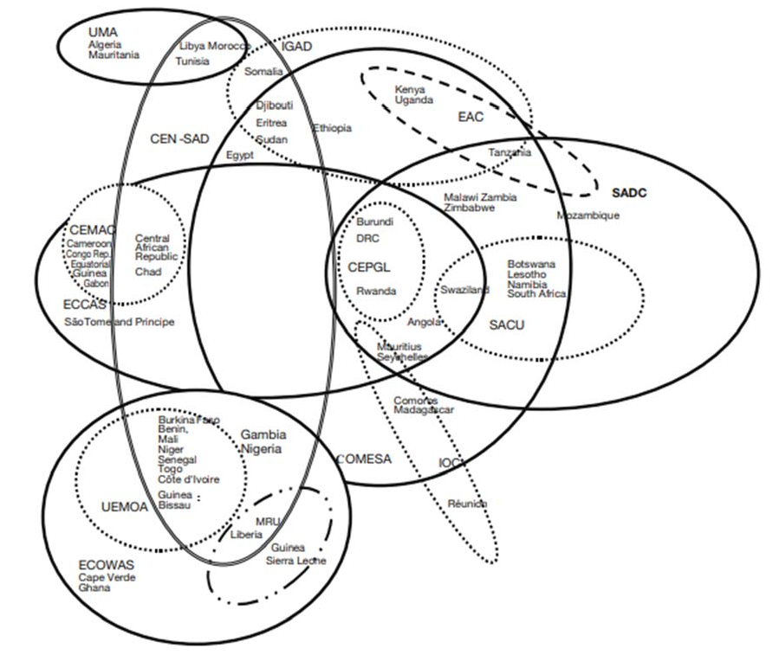
RECs and Migration
There are eight RECs in Africa that are recognized as building blocks of the AU, namely the AMU, CEN-SAD, COMESA, EAC, ECCAS, ECOWAS, IGAD and SADC
The spaghetti bowl of overlapping regional economic community memberships

Slide 9
Key RECs Policies on Migration/Displacement
ECOWAS
CEN-SAD
COMESA
EAC
16 MS
1979 Protocol on Free Movement of Persons
2008 Common Approach on Migration
2009 Regional Labour and Employment Policy and Plan of Action since
2011 ECOWAS Gender and Migration Framework and Plan of Action
29 MS
Migration not central for this REC
More pressing issues include agriculture and natural resources management, crisis and dispute reconciliation among members (Libya, Darfur conflict).
Its revised treaty mentions the fight against cross-border organized crime and its related activities, including human beings
19 MS
1984 Protocol on the Gradual Relaxation and Eventual Elimination of Visa Requirements from and 2001 Protocol on the Free Movement of Persons, Services, Labour and the Right of Establishment and Residence
COMESA Model Law on Immigration was set up in 2006 but progress has been slow
7MS
In 2010 EAC Common Market came into force
Provisions the freedom of movement of persons; removal of restrictions on the movement of labour and services; and the right of establishment and residence
Draft Refugee Management Policy in place

Slide 10
Key RECs Policies on Migration/Displacement
SADC
ECCAS
AMU
IGAD
15 MS
SADC is primarily focused on security issues, despite the prevalent nature of labour migration
1996 Free Movement of Persons protocol reviewed in 2005 but yet to come into force.
6 of the required 10 MS have ratified the protocol.
Draft Regional Policy Framework on Management of Asylum Seekers & Refugees in place
11 MS
Primary focus on Peace, security and stability, Infrastructures, and Environment
The 1983 Protocol on Freedom of Movement is yet to come into force
2013 regional migration policy-Implementation low
5 MS
Only Tunisia gives citizens from the other member states free access to its territory
Activities within the region have been ‘frozen’ over the past years, mainly due to lack of political will among member states
7 Active MS.
Free movement Protocol Adopted in 2021-Awaiting ratification
2012 Regional Migration Policy
2017 Nairobi Declaration on Somalia Refugee and Plan of Action

Slide 11
Migration and Displacement in the IGAD Region
A region of historical migration
Different drivers of migration and displacement- mixed migration
Region of cross border trade that’s not considered “regular”
No widespread “free movement “ regime
The reality of recurrent drought disasters
Protracted displacement averaging 11 years
Migration movements are within the region, to the Gulf, Europe and South Africa.

Slide 12
An overview of Migration and Displacement in The IGAD region

Slide 13
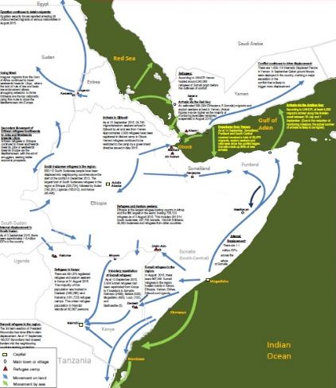
Key migration trends
Migration movements are within the region, to the Gulf, Europe and South Africa.
Three main Migration routes:
The Eastern Route (gulf of Aden migration route): through Djibouti, Northern Somalia, Yemen and eventually to KSA and other Gulf countries.
Experiencing reversed flows from Yemen; including Yemenis, TCNs, and returning Ethiopians and Somalis
The Northern Route: through Sudan, Libya, Egypt into Europe.
The Southern Route: through Kenya, Tanzania, Zambia, Malawi and South Africa

Slide 14
Key Priorities
Migration Governance Architecture
Comprehensive National Migration Policy
Labour migration
Border management
Irregular Migration
Forced Displacement
Internal Migration
Migration Data
Migration and Development
Inter State and Inter regional Cooperation
Migration, peace and security
Migration and Environment

Slide 15
Frameworks for Durable Solutions
IGAD Migration Policy Framework 2012
Migration Action Plan 2015
Global Compact on Refugees, NY Declaration and CRRF
Pledges made at the Leaders’ Summit
CRRF/GCR
Nairobi Declaration and Plan of Action – March 2017
Regional application of the CRRF/GCR
Development approach: ease pressures on host communities

Slide 16
