Slide 1
International cooperation on migration and mobility
Martin Ruhs
Migration Policy Centre (MPC)
European University Institute (EUI)
Kampala, 22 July 2022

Slide 2
The plan …
Example: Migrant workers in the Gulf States – in whose interests? What can and should origin countries do?
Why do we need cross-country cooperation? The effects of migration – who assesses and decides? Elusive triple wins …
The importance of process and «fair representation» in the design and implementation of cooperation agreements
Example 1: Bilateral Labour Migration Agreements w. Gulf States
Example 2: EU-Africa partnerships on migration
Group discussions

Slide 3
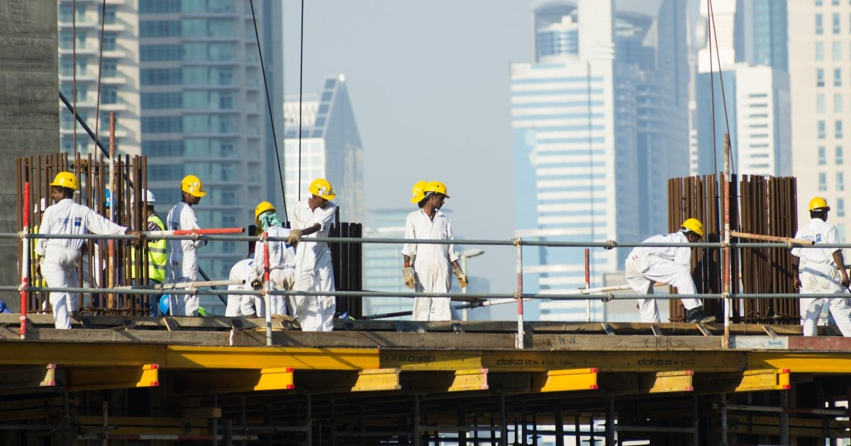
Migrant workers in the Gulf States

Slide 4
Why do we need international cooperation?
Multi-dimensional and multifaceted impacts of migration on:
Receiving countries
Migrants
Origin countries
The elusive triple «wins»:
Who assesses and decides?
Why is ‘revealed preference’ not enough?

Slide 5
The importance of ‘process’
Fair representation in the design and implementation of international migration cooperation agreements
Key challenges:
Power asymmetries (regulating immigration vs emigration; high- and lower-income countries)
Non-democratic countries: in whose interests?
«Red lines» e.g. basic human and labour rights protections
How to best represent the interests of migrants?

Slide 6
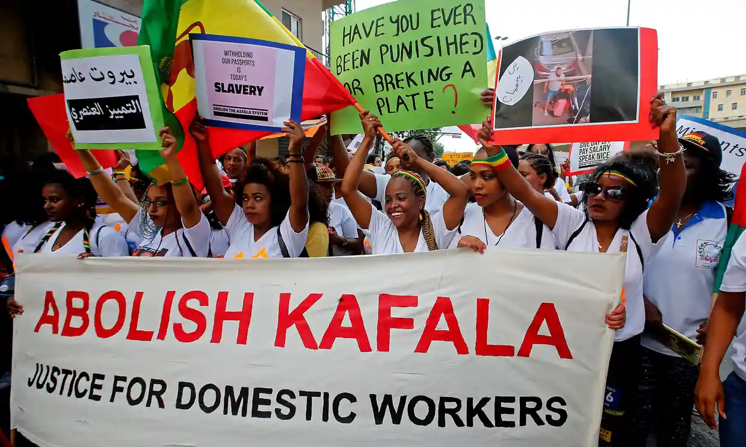

Slide 7
Example 1: Bilateral Labour Migration Agreements, in context of labour migration to the Gulf States
Kafala system (‘reforms’ in some countries?)
High shares of migrant labour in workforce, great diversity of origin countries
Well-known and well-documented violations of fundamental rights, especially (but not only) in domestic services
Many origin countries negotiate Bilateral Migration Agreements
Regulation of labour emigration, «emigration bans» (ethics?)
Origin countries perceive tension between promoting labour emigration (and remittances) vs protection of basic rights
Cooperation among origin countries?

Slide 8
Example 2: EU-Africa partnerships on migration
Key dimensions of partnerships:
Legal pathways incl labour migration
Max pos. developmental benefits from migration
Control irregular migration
Return and readmission
Protection of migrants’ rights
Assessment so far? How ‘comprehensive’? Shared objectives? How to improve processes ?

Slide 9
Group discussion 1: How to design and implement a bilateral labour migration agreement ?
- Rights protections
Right to redress
Information
Return
Role of origin countries vs host countries?
Process
Representation of interests of migrants
Potential competition/cooperation with other origin countries?
Emigration bans ?

Slide 10
Group discussion 2: How to design and implement EU-Africa cooperation on migration ?
- Level of governance: country-to-country? Role of EU and AU?
Which dimensions should be covered: narrow or comrehensive approach?
Border control? Emigration / immigration?
What about return and readmission? Citizens vs non-citizens?
What types of legal pathways?
What should be role of human rights protections? How to monitor and implement in practice?
Emigration bans ?
Role of conditionality?

