Slide 1
Regional Approaches on Labour Migration and Mobility in Africa
Linda Adhiambo Oucho

Slide 2
OBJECTIVES AND OUTCOMES
Overview of labour migration in Africa
State of labour migration in East and Horn of Africa
Review of Continental and Regional frameworks: Focus on Labour migration
Continental and regional instruments on labour migration
Programmes and initiatives on labour migration and Mobility in East and Horn of Africa
Approaches on labour migration in East and Horn of Africa
Developing labour migration programmes
Group Work & Presentation

Slide 3
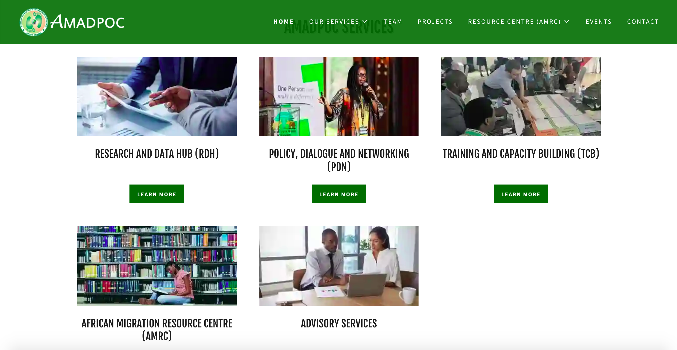

Slide 4

Labour Migration in Africa
Facts and Figures

Slide 5
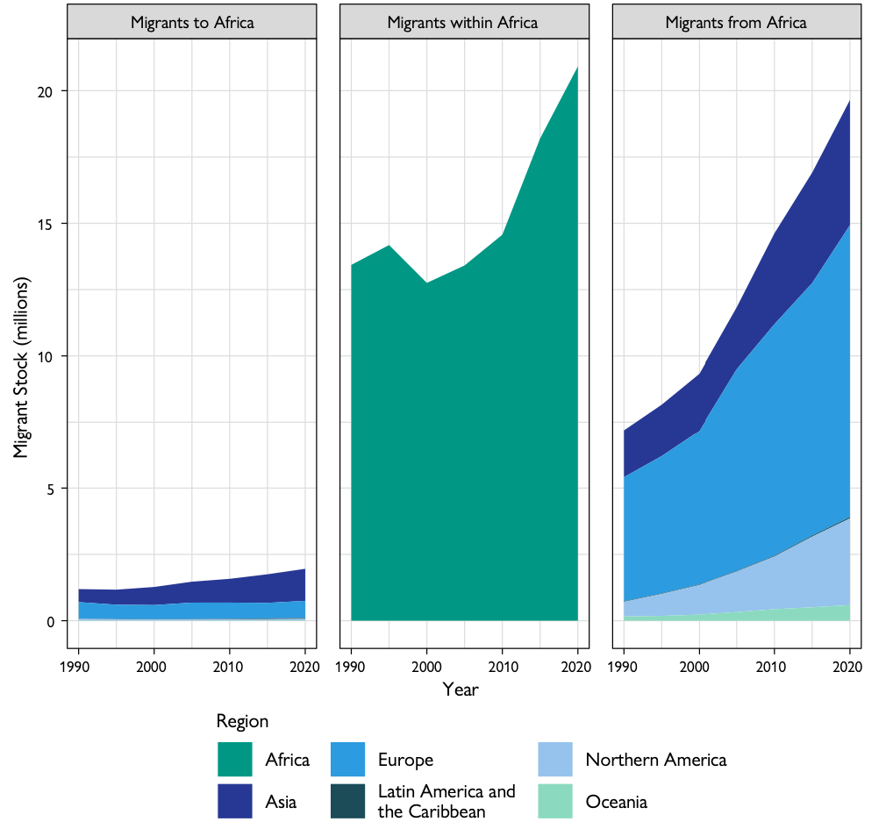

Slide 6
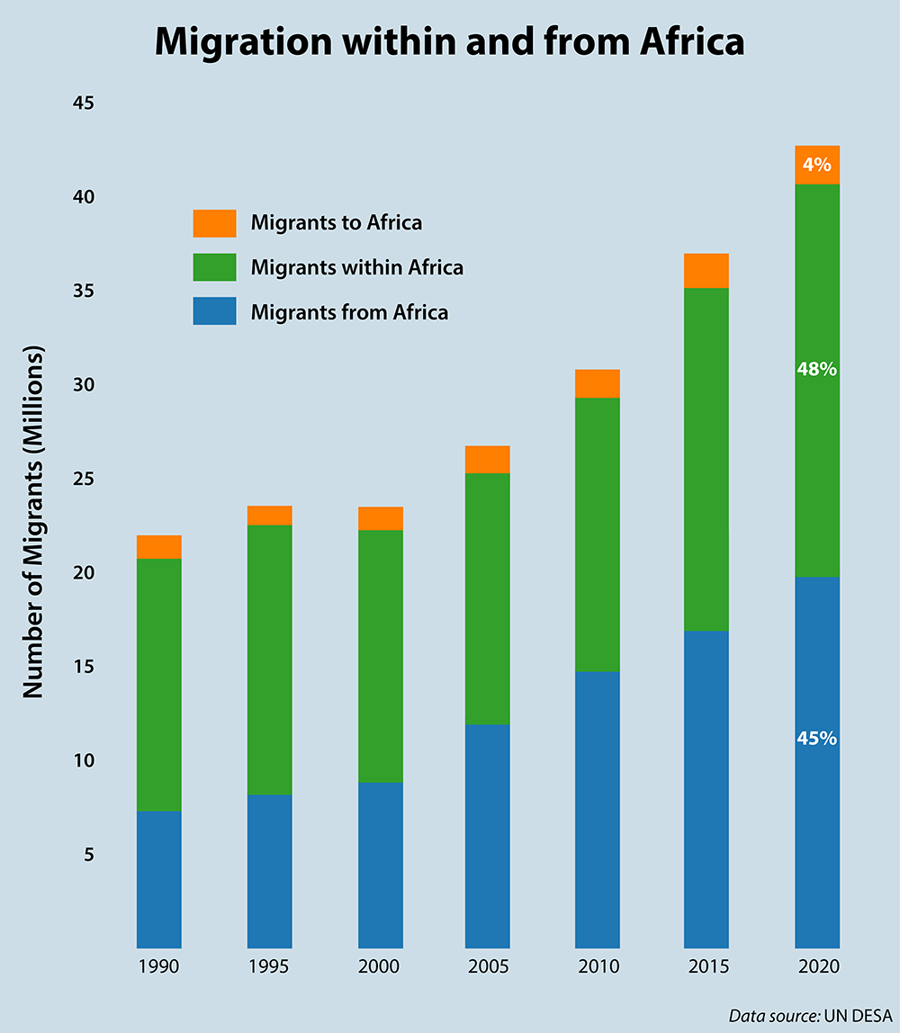
FACTS
More inter- and intra-regional migration taking place
Migrants more likely to move to a neighbouring state
Cross border migration very common in the EHoA region, with women increasing engaging in cross border trade
Youth are the majority seeking opportunities in other regions and beyond

Slide 7
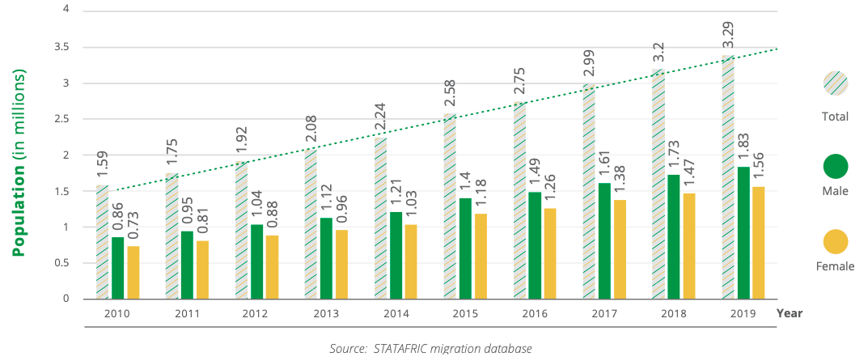
Migrant Labour Force in IGAD Region

Slide 8
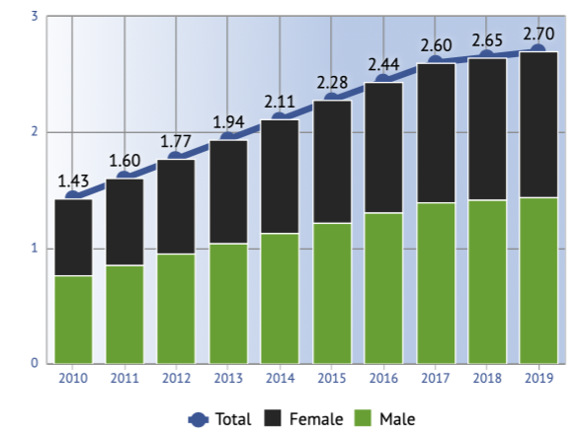
International Migrants in Labour Force, EAC

Slide 9
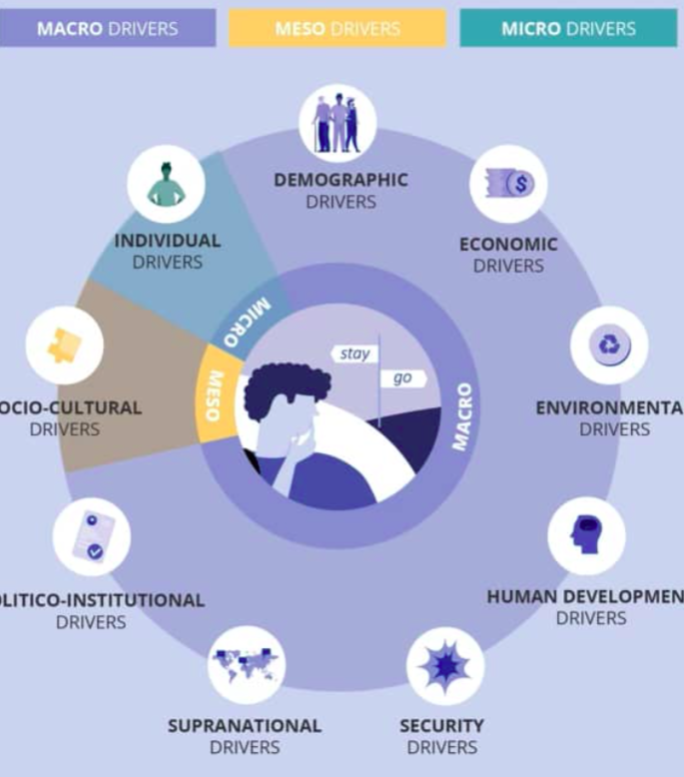
Migration drivers
Who moves….
  Skilled - Unskilled
  Men + Women + Youth
Why they move….
  Demographic (Macro)
  Economic
  Environmental
  Human Development
  Security
  Supranational
  Politico-Institutional
  Socio-cultural (Meso)
  Individual (Micro)
How they move…
  Regular Vs Irregular

Slide 10
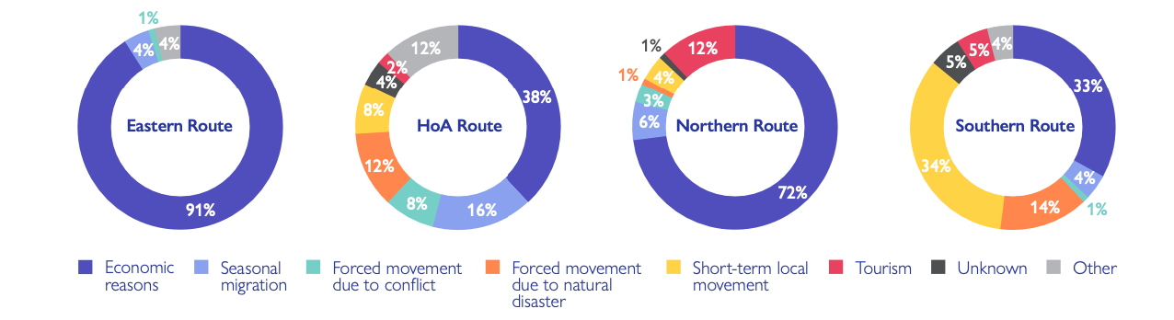

Slide 11
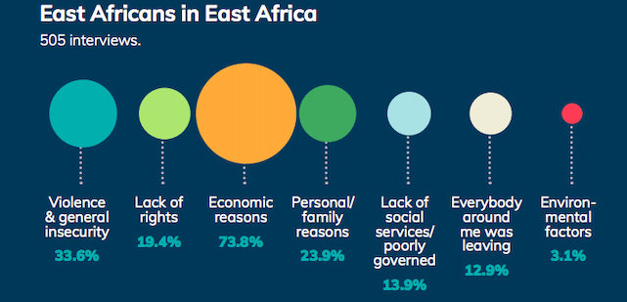
Notes:
Mixed Migration Report 2019

Slide 12
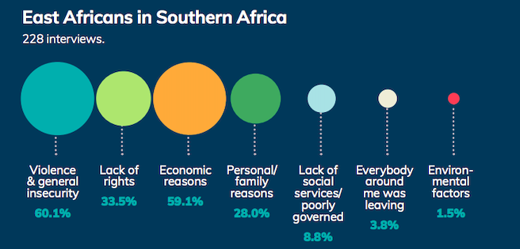
Notes:
Mixed Migration Report 2019

Slide 13
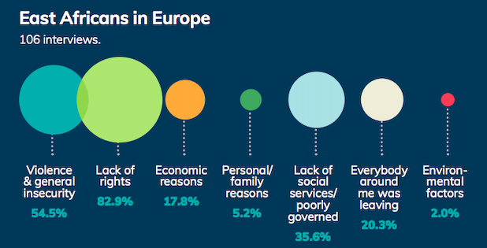
Notes:
Mixed Migration Report 2019

Slide 14
IMPACT OF LABOUR MIGRATION
ECONOMIC
Financial remittances + Sector development + Social remittances (untapped potential_
SOCIAL
Labour migrants working in other countries integrate and learn about other cultures in the host country. Potential to strengthen REGIONAL INTEGRATION bringing the citizens together
MODERN SLAVERY
Addressing human trafficking and migrant smuggling where labour migrants are at risk of exploitation and abuse because there are no measures in place to protect them in transit and destination. Or limited resources to support them when in distress
XENOPHOBIA
Rise in xenophobia against migrants’ resident in the country

Slide 15
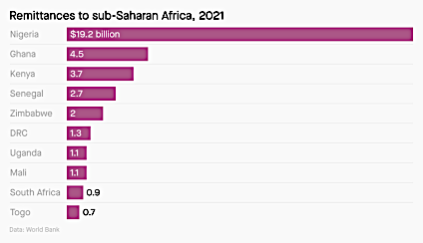

Slide 16
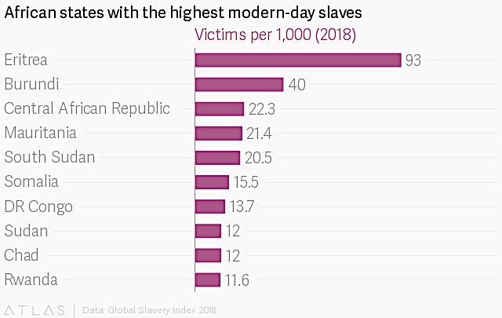
Balancing act: How do you ensure that labour migrants are protected and access decent work and reduce the risk of enslavement and abuse?

Slide 17

Labour Migration Governance
Legal Instruments and Governance Structure

Slide 18
Global and Continental Frameworks
International
  International Labour Standards (ILO)
  Global Compact on Safe, Orderly and Regular Migration and Global Compact on Refugees
Continental
  AU Plan of Action on Employment Promotion and Poverty Alleviation (2004)
  AU Common Position on Migration and Development
  AU Social Policy Framework (2008)
  AU Minimum Integration Programme (2009)
  Declaration on Migration (2015)
  Migration Policy Framework for Africa and the Plan of Action (2018 – 2030)
  African Continental Free Trade Agreement (2018)
  AU Continental Free Movement Protocol (2018)

Slide 19
EAC Frameworks on Labour Migration
East African Common Market Protocol (2010)
  Part D Article 10 on free movement of persons and labour
  Part D Article 11 Mutual recognition of skills
East Africa Qualifications Framework for Higher Education (2015)
  Recognition of Prior Learning Regional Framework (discussions)
EAC Vision 2050
Council of Directives on Social Security (draft)
East African Labour Migration Policy Framework (draft)

Slide 20
IGAD Frameworks on Labour Migration
IGAD Regional Migration Policy Framework (2012)
  Migration Action Plan
Djibouti Plan of Action on Refugee Education in IGAD Member States
Djibouti Declaration on Labour, Employment and Labour Migration in the IGAD region
Regional Education Policy Framework (2020)
  Regional Qualifications Framework (draft)
Protocol on the Free Movement of Persons in the IGAD Region (2020)
  Phase II: Right of Movement of Workers

Slide 21




LABOUR MIGRATION CONSIDERATIOINS
Mutual Recognition of Skills
Right of Establishment
Free Movement of Persons
Migrant Worker Protection
Right of Residence
  Are there barriers towards accessing a country for labour migrants for citizens of a region? E.g. work permit costs, lengthy procedures
Are your skills, qualifications and experience easily recognised in other member states
Once in the country, are migrant workers protected under the national law of the host country? Denial of wages
Can you establish a business and invest in other member states? Is it expensive to establish a business
Are you able to reside in another member states? Is it an expensive or tedious process

Slide 22
Observations of Labour Migration Governance in EHoA
BUILDING CONSENSUS TAKES TIME and impacts the decision-making process in the Community
DELAYED HARMONIZATION of national laws that comply with the regional frameworks impacts the implementation activities
INADEQUATE RELIABLE AND TIMELY DATA to monitor the state of free movement of persons at regional level BUT there is ongoing capacity strengthening in the EHoA region statistical institutions
CAPACITY STRENGTHENING should be an ongoing process at different stages of implementation to respond to the evolving environment.
LOCALISATION OF THE FRAMEWORK TO REGIONAL CITIZENS is an important balance between knowing the opportunities available to citizens but also knowing their rights as migrant workers throughout the migration cycle.
MUTUAL REGCOTION OF SKILLS including formal and informal skills in the Mutual Recognition Agreements need to be expedited to facilitate labour migration

Slide 23

Labour Migration Programmes and Initiatives

Slide 24
TOOLS TO DESIGN PROGRAMMES
SCALE UP
DIALOGUE
Discussions with the key stakeholders within a country/region helps to identify a common challenge/problem that needs a solution. E.g. Member state meetings with REC members, Technical meetings with UN Agencies such as ILO and IOM
Expanding the programme to cover a wider region and target group and depends on the impact of the programme – did it achieve its objective(s)?
01
05
02
RESEARCH
Research is used to understand the nature of the problem through DATA and the human experiences behind the numbers
EVALUATIONS
Evaluations tell us how well the programme is doing throughout the cycle identifying successes and challenges that need to be addressed
ASSESSMENTS
04
Assessment are used to identify a problem in a country/location by assessing the WHO, WHAT, WHERE, HOW and WHEN questions. They help to shape the design of a programme
03

Slide 25
Interactive Session
Name or Describe any of the following you know of or have been involved in:
DIALOGUES on Labour Migration
RESEARCH on Labour Migration (Continental, regional or National)
ASSESSMENT on Labour Migration
PROGRAMMES SCALED UP on Labour Migration

Slide 26
Dialogue: Pan-African Forum on Migration (PAFOM)
Interregional forum for the African Union Commission and its Member States bringing together all stakeholders addressing a wide range of migration-related issues
Thematic areas covered:
  Migration Governance + Regional Integration + facilitation of free movement of persons + facilitated trade + integrated border management + visa regimes + combatting irregular migration
The platform allows for best practices to be shared from the regional consultative processes (RCPs) in Africa and at the national level
  Kigali Roundtable 2015 Intra-Regional Migration and Labour Mobility within Africa
  Inception phase of the Regional Joint Labour Migration Programme (JLMP)
  Djibouti PAFOM (2018) focused on Free movement of Persons across Africa

Slide 27

Programming: Joint Labour Migration Programme
Joint Programme on Labour Migration Governance for Development and Integration in Africa launched in 2018
JLMP is an interagency partnership between AUC + ILO +IOM +UNODC +UNECA
Strengthen labour migration governance to ensure safe, orderly and regular migration
National and Regional Governance Structures
Realise the development and implementation of the national instruments guided by the regional instruments
Member States identify their areas of focus and interest based on:
  Migration Profiles
  Capacity and Resources Needs
  Governance Structure

Slide 28
Regional Ministerial Forum on Migration
Regional Ministerial Forum on Migration (RMFM) established in 2020
Brings together 11 Member States in the IGAD and EAC region to harness labour migration within the wider region and ensure the rights of migrant workers are respected.
Thematic areas of discussion include:
  Bilateral Labour Migration Agreements
    Uganda hosted Regional workshop on Bilateral Labour Migration Agreements (BLMAs) on 16 May 2022 with representatives from Ministries of Labour from Ethiopia, Kenya, Uganda, Rwanda, Somalia, South Sudan and Uganda
  Focus was to include migrant workers and their families in healthcare in
  Migrant worker rights
  Gender mainstreaming into policy and practice
  Labour Market Information Systems

Slide 29
Better Regional Labour Migration Programme
Funder: Foreign, Commonwealth and Development Office (FCDO)
Implementing Agencies: ILO and IOM
IOM aims to support 4 TWGs focused on:
  Mobility, Regional Integration, Social Cohesion considering the EAC-CMP and IGAG-FMP and other continental instruments (AfCFTA and FMP)
  Ethical Recruitment, BLMAs, consular cooperation, migrant workers and their families’ rights
  Returning migrant workers and members of their families addressing vulnerabilities, protection needs and risks of return and reintegration in EHoA
  Gender-responsive migration governance iin the EHoA region
Target Countries: 11 Countries in the EHoA region
Activities:
  Research has been conducted in selected 11 countries in the EHoA on the migrant worker rights + gender mainstreaming + labour market information system…..

Slide 30
Types of Labour Migration Programmes: National Level
Social Security
Labour Migration
Labour Migration Governance
Diaspora Engagement

Slide 31
2008–2011
Strategies for extending social security to migrant workers and their families from and within Africa (MIGSEC)
2012
Resource mobilisation among migrant communities for heal microinsurance programme implemented (Mali and Senegal)
2006 - ongoing
Assisted Voluntary Return and Reintegration (Senegal)
2007 - 2008
Rapid Reaction Mechanism (RPM) (Senegal)
2013 - 2016
Mobility and Migration for Development Programme (Mali)

Slide 32
2016 - 2021
EU-IOM Initiative for Migrant Protection and Reintegration (Nigeria, Mali and Senegal)
Engagement of border communities for border security and management (Senegal)
Comprehensive Migration Management Strategy (COMMIST) (Tanzania)
2014 - 2016
2017 - 2019
2018 - 2022
Better Migration Management Programme (EHoA)
2019 - 2020
Initiative for Labour Migration Employment and Reintegration in Nigeria and Ghana (LMER)
2018 - Ongoing
Joint Labour Migration Programme (JLMP)
Regional and National

Slide 33

Group Work

Slide 34
Instructions
What are some of the key labour migration issues facing your country/ region?
  Identify at least 2 labour migration issues that you believe need to be addressed
  What tool(s) did you use to identify the problem?
Think about the national/regional instruments that you think can address the labour migration issue identified in question 1?
Based on the above, propose the type of programme/initiative to address some of the labour migration issues in the EAC/IGAD.
  Factor: demographic factors, economic, social, political and environmental factors and existing emergencies such as climate change and the COVID 19

Slide 35
Key Issues to Identify
ISSUE
  What is the issue and what tool(s) did you use to identify the issue
REGIONAL/NATIONAL INSTRUMENTS
  Identify the regional/national instrument that you think can address the problem
TYPE OF PROGRAMME
  Design a programme(s) to address the problem
TARGET GROUP/LOCATION
  Identify the target group/location where the programme will be implemented
METHOD OF IMPLEMENTATION
  Identify the resources need to implement + Time Frame + Explain how the programme can be sustainable
DESIRED IMPACT
  What is the desired and unintended impact

